Slide 1
INF0 341 Network Basics – LANs, WANs, & DMZs
By
Bob Larson

Slide 2
Topics Covered
Basic Design of LAN and the Internet
LAN Addressing and Delivery
Gateway Router or Firewall
Address Resolution Protocol (ARP)
DHCP (Dynamic Host Configuration Protocol)
DNS (Domain Name Service)
NAT (Network Address Translation)

Slide 3



Basic Design of LAN and the Internet
Public Network (Public IPs) WAN
LAN – Local Area Network
Belongs to single entity
Typically uses private IP addresses
Relatively safe
Uses MAC (L2) address to communicate
Public Networks
No entity owns or controls
Requires public (real) IP addresses
Relies on trust for compliance (?)
Uses IP addresses to locate devices
Still uses Layer 2 addresses for delivery
DMZ – Demilitarized Zone
Owned by the LAN entity
Accessible from inside or outside LAN
Outside facing servers (Public)
Web Server
Internet
1.1.1.10
Email Server
Web Server
.9
1.2.2.2
DMZ
.10
Router or Firewall
.115
.180
10.0.0.1/24
.111
.5
File Server
Switch
.159
.6
Web Server
WiFi Access Point
Company LAN
.100
.121
.113
.170
LAN – Private Network (Private IPs)

Slide 4
LAN Addressing and Delivery
Public Network (Public IPs) WAN
Typically Ethernet
Single Network LAN
All devices share same IP address pool
Same Network ID and Subnet mask
Example: 10.0.0.0/24
Multiple Network LAN
More than one IP address pool
Router or L3 switch for inter-LAN exchanges
Switches (L2) and A/Ps pass-through
Only need IP addresses for management
All data frames delivered via MAC (L2)
Uses ARP to resolve IP to MAC addresses
Default Gateway to access outside world
Web Server
Internet
1.1.1.10
Email Server
Web Server
.9
1.2.2.2
DMZ
.10
Router or Firewall
.115
.180
10.0.0.1/24
.111
.5
File Server
Switch
.159
.6
Web Server
WiFi Access Point
Company LAN
.100
.121
.113
.170
LAN – Private Network (Private IPs)

Slide 5
Gateway Router or Firewall
Public Network (Public IPs) WAN
Gateway connects LAN to outside world
Inside part of LAN shares that IP address pool
Outside public address typically from ISP
Could connect to home office for Internet (rare)
Connect to DMZ (optional)
A secure design for publicly shared servers
These servers are often outsourced now
Can provide these services to LAN
DHCP* to assign user IP addresses
DNS* to convert URLS to IP address
NAT to allow users go out into the Internet
NTP* to provide synchronized time
VPN encrypted links to remote public sites
Controlled access to DMZ
Web Server
Internet
1.1.1.10
Email Server
Web Server
.9
1.2.2.2
DMZ
.10
Router or Firewall
.115
.180
10.0.0.1/24
.111
.5
File Server
Switch
.159
.6
Web Server
WiFi Access Point
Company LAN
.100
.121
.113
.170
LAN – Private Network (Private IPs)
* Could be performed by servers

Slide 6
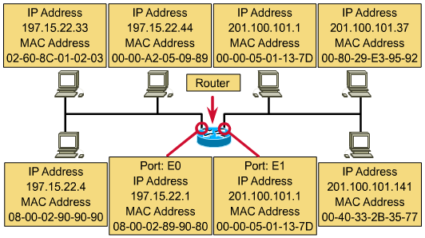
Address Resolution Protocol (ARP)
1
Internet
Maps IP addresses to MAC addresses
MAC address is used by Ethernet to deliver frames in the local segment
IP Address identifies network ID (197.15.22.0 / 201.100.101.0) and host ID
Used to move packets from network to network

Slide 7
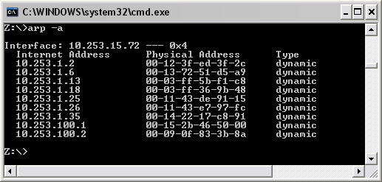
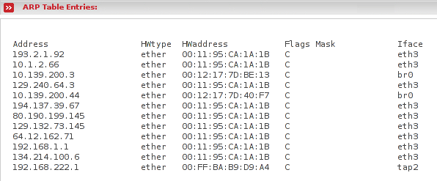
ARP (Address Resolution Protocol)
On a Computer, Smartphone, etc.
On a Switch with IP management
LANs use only Ethernet MAC address for delivery
Routers use IP addresses to find the network to forward data to
ARP maps network address (IPv4) to a MAC address
Defined by RFC 826 in 1982
Use ARP requests (broadcast) to find an IP address, learns MAC from reply
Each connected device maintains ARP table of results
Note: Not the same as CAM table in a switch

Slide 8
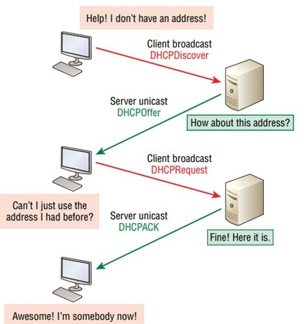
DHCP (Dynamic Host Configuration Protocol)
Used in IPv4 networks to assign IP address
Plus other configuration information
Default gateway, domain name, DNS servers, and time servers (NTP)
Also supplies information for IP phones and other technologies
Eliminates the need for manual configuration
Particularly important with mobile devices that come and go
Router or firewall device can act as DHCP server
Larger networks administered by one or more DHCP server(s)
New device issues a DHCP request broadcast
After brief exchange server provides the configuration information
Issued as a renewable lease so that inactive addresses are recaptured

Slide 9
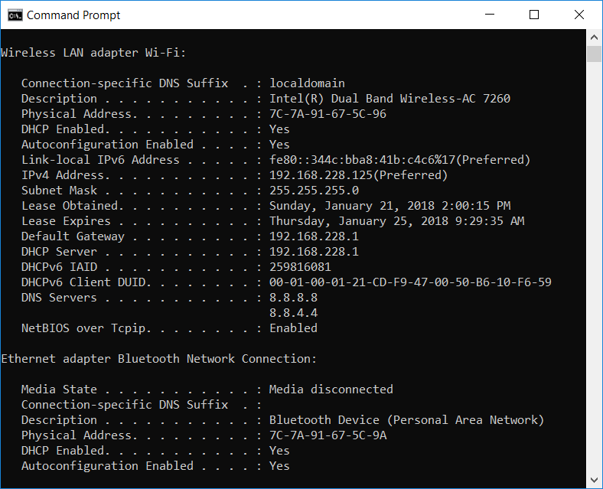
Configuration Supplied by DHCP

Slide 10
DNS (Domain Name Service)
Subdomain
Domain Name
Mail Box
Domain Name
URL: http://iSchool.uw.edu Email Account: BobLarson@uw.edu
Hierarchical decentralized naming system
For computers, services, or other resources
On the Internet or a private network
Translates easy to remember domain names to IP addresses
Worldwide, distributed service essential to the Internet
Provides redundancy
No single point of failure
It scales well
Been in use since the 1980s

Slide 11
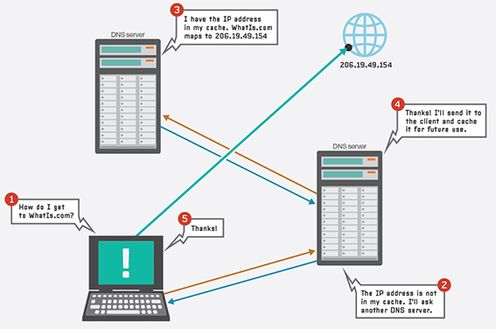
DNS Example
Device sends request to Local or ISP DNS Server for domain name only
If server doesn’t recognize
It forwards request upstream
When IP is returned
Each DNS handling the request adds it to its database
Assumes if you asked once, you will likely ask again in the near future

Slide 12
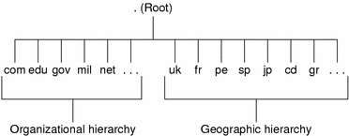
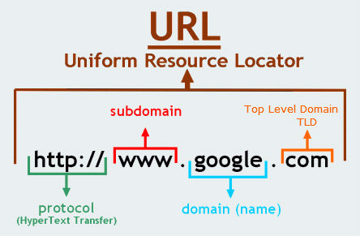
DNS Structure
Original TLDs
Com
Org
Net
Int
Edu
Gov
Mil
For each country
EDU
Top Level Domain (TLD)
MIT
WSU
UW
Second Level Domain
http://iSchool.uw.edu
…
LAW
iSchool
MBA
Subdomain
…
iSchool.uw.edu

Slide 13
NAT (Network Address Translation)
Public Network (Public IPs) WAN
Replace a frame’s IP configuration with another
Switch a private IPv4 address with a global IP
To go on the Internet
Private addresses could preserve global IPs
Private IPs are free, global addresses cost money
Global IP can come from
A pool supplied by your ISP or
The outside interface of the NAT router or firewall
NAT device maintains a NAT translation table
To direct returning traffic to appropriate inside host
NAT provides a level of anonymity for inside hosts
Typically connections must originate from inside the local network
Server
Internet
1.1.1.10
Email Server
Web Server
.9
1.2.2.2
DMZ
.10
Router or Firewall
.115
.180
10.0.0.1/24
.111
.5
File Server
Switch
.159
.6
Web Server
WiFi Access Point
Company LAN
.100
.121
.113
.170
LAN – Private Network (Private IPs)

Slide 14
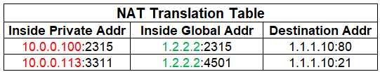



NAT (Network Address Translation)
Public Network (Public IPs) WAN
Server
Internet
1.1.1.10
Email Server
.100 to Router
Web Server
.9
1.2.2.2
DMZ
.10
Router or Firewall
.115
.180
10.0.0.1/24
Router to Server
.111
.5
File Server
Switch
.159
.6
Server back to Router
Web Server
WiFi Access Point
Company LAN
.100
.121
.113
.170
Source & Destination IP & Ports Reverse
LAN – Private Network (Private IPs)

Slide 15
Fin…

